Slide 1

Background to Newton’s Principia
Newton’s monumental Principia mathematica was published in 1687. A second edition appeared in 1713, and a third edition in 1726.
This book provided the foundation for classical mechanics and our modern picture of the cosmos.

Slide 2
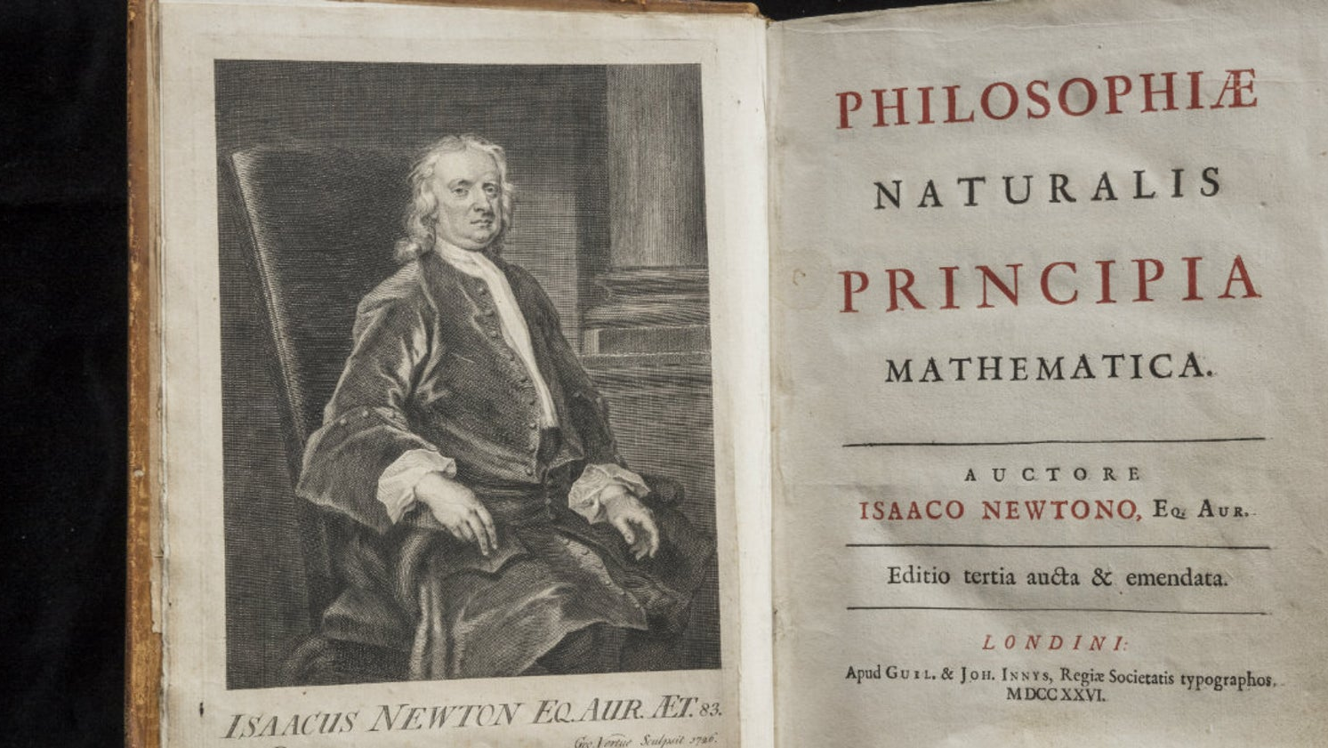

Slide 3
Hooke’s Problem
In 1679, Hooke had a brief discussion Newton, asking him what would be the path of a body given that the Earth ‘s “attraction” varied inversely as the square of this distance. Hooke pointed out publicly that the path would be an ellipse with a focus at the centre of the Earth. (In fact, the focus would be the center of attraction).
It was Hooke (though he has received little recognition for providing this insight) who first related Kepler’s elliptical orbits to the motion of a projectile under the Earth’s gravitation.

Slide 4
Halley’s Problem
By the early 1680’s, a number of mathematicians had deduced from Kepler’s third law that the Sun’s gravitation must vary inversely as the square of the distance.
Halley turned to the more intricate problem of finding the path of a body moving under such an attraction and failed.
Halley visited Newton in 1684 and asked presented a problem (Halley’s problem) to Newton: what the path of a moving body would be under the influence of gravity varying in the inverse square.
Newton claimed that he had made this calculation in 1679 but now in 1684 could not find it. He quickly wrote up a short manuscript and sent it to the Royal Society. He said that he would look more closely at the issues and write up a fuller account. He spent the next two years writing this fuller treatment.

Slide 5

Newton’s problem
Halley simply assumed that the gravitational force acted as the inverse square and asked Newton to deduce (predict) the planetary motions from this assumption. Newton regarded this as a simple mathematical puzzle that anyone could solve.
Newton focused his intellect on a different and much more difficult problem; namely, providing a scientific foundation for the contention that the force of gravity acts inversely as the square of the distance.
Newton says that he will “deduce” (but really means “induce”) this contention from “the phenomena of motions”).

Slide 6
Newton’s Style of Reasoning
“The whole burden of philosophy seems to consist in this — from the phenomena of motions to investigate the forces of nature, and then from these forces to demonstrate the other phenomena; and to this end the general propositions in the first and second Books are directed. In the third Book, I give an example of this in the explication of the System of the World; for by the propositions mathematically demonstrated in the former Books, in the third I derive from the celestial phenomena the forces of gravity with which bodies tend to the Sun and the several planets. Then from these forces, by other propositions, which are also mathematical, I deduce the motions of the planets, the comets, the Moon, and the sea.”

Slide 7
This second problem can be broken down into two further problems.
First, there is the analysis of the data concerning the orbits of the planets round the Sun, to the approximation that these orbits are circular with the Sun at the center. This is a difficult problem in view of the fact that the observational basis itself is suspect in Newton’s mind. The observations are produced by a complex number of factors, so Newton’s task is to discover just why the motions approxi­mate circular orbits. There is hint here given by the implication of the inverse square proportion, namely, that the planets should describe ellipses with the Sun in one focus. They do not and so the trick is to find out just why.
The second problem is to show the universality of gravitation. Newton’s analysis of the motion of the Moon holds the key to his solution to this problem.

Slide 8
Elements of Newton’s Argument
1. Definitions of space, time, and motion.
2. General principles of motion and force, including Newton’s three laws of motion.
3. Rules of Reasoning.

Slide 9
1. Definitions of Space, Time, and Motion
These concepts ultimately depend on Newton’s idea of God, of whom it is impious to think that he did not know where he was or what time it might be. Even without bodies or universes as landmarks, there must be absolute space and time. As Newton says at the end of Book III, “He endures forever, and is everywhere present; and, by existing always and every­where, he constitutes duration and space.”

Slide 10
2. General Principles of Force and Motion
These principles are positioned as “Axioms” at the beginning of the Principia, and a formidable battery of theorems derived from them in the preceding Books, especially Book I. (Together with the definitions, these constitute the first coherent statement of the fundamental laws according to which the motions of bodies are produced.) Among these axioms are Newton’s famous laws of motion:
(1) Every body continues in its state or rest, or of uniform motion in a right line, unless it is compelled to change that state by forces impressed upon it;
(2) The change of motion is proportional to the motive force impressed; and is made in the direction of the right line in which that force is impressed; and
(3) To every action there is always opposed an equal reaction: or the mutual actions of two bodies upon each other are always equal, and directed to contrary parts.
Newton credits Galileo with the first two laws, but the second law is a definition of measurement of kinetic force that Galileo never attained and that makes Newton the founder of dynamics, a term that was coined by Leibniz to characterize his concept of force that corresponds roughly to the modern concept of kinetic energy.

Slide 11
Newton’s ontology of force
Scholars have interpreted the procedure advanced in this passage as encapsulating the very essence of the Newtonian revolu­tion in science. Though Newton’s ontology included material corpuscles in motion. It also included the notion of force. Armed with the principle of inertia, force was held to change (or tend to change) the motions of bodies — the measure of the changes of motion serving as the measure of the force. The chief object of science became the discovery of the various forces acting in the world.
Another important factor is that, in Newton’s hands, the notion of force became a quantity. His approach thus held out the prospect for a truly mathematical physics in which various natural effects would be shown to follow in a rigorously demon­strative and quantita­tively exact manner from mathematically expressed laws of force.

Slide 12
Concerns about Gravitational Attraction
This concept was dismissed by many critics as an occult quality, calling for bodies situated a distance apart to act on one another across empty space.
Newton replied to his critics that he had demonstrated from the phenomena that attraction is a property of some bodies and generalized this claim to include all bodies. In the General Scholium to the Principia, written some twenty-six years after the publication of its first edition, Newton put the matter this way: “To us it is enough that gravity does really exist, and act according to the laws which we have explained, and abundantly serves to account for all the motions of the celestial bodies, and our sea.”

Slide 13
The Cause of Gravitation?
Newton recognized that he was not in possession of the cause of gravitation, of whose existence he was convinced. He tried to give a mechanical explanation in terms of an ethereal substance pervading all bodies and filling the space between them. But he was never able to demonstrate its existence in the way he thought he had demonstrated the existence of gravitation itself. In the General Scholium, he asserted that experim­ental philosophy has no room for such “hypotheses.” He would not, like his opponents, invent hypotheses merely to fill an explanatory gap.

Slide 14
Motion of Bodies in Resisting Media
The second book of Newton's great work features a mathematical analysis of the motion of bodies in resisting media; in effect, this book is a sustained examination of the dynamical conditions of vortex motion. A number of arguments are generated against the possibility of vortices; in particular, Newton argues that the vortex theory cannot be reconciled with Kepler's laws of planetary motion. The problem stems from the incompatibility between the velocity relations in Kepler's second and third laws. Applied to a single vortex, Kepler's second law requires the speeds of its layers to vary inversely as the distances; whereas the third law of periodic times demands that the speeds vary inversely as the square of the distances. The consequence is that the visible center of a vortex — any planet will do nicely — would have two different speeds at the same time.

Slide 15
Leibniz and the Principia
After reading a 12 page review of the Principia in Acta Eruditorum in 1688, Leibniz immediately countered what he perceived to be a damaging blow to the vortex theory of planetary motions with his "Essay on the Causes of the Motions of the Heavenly Bodies," that appeared in the February 1689 issue of the Acta. Leibniz's "Essay" set a precedent for Cartesian science by investigating the soundness of Kepler's laws in a world of vortices; i.e., in a world where motion encounters resistance as a matter of course. Kepler is characterized by Leibniz as "that incomparable man" whom "the fates have watched over that he might be the first among mortals to publish the laws of the heavens, the truth of things, and the principles of the gods".

Slide 16
Kepler’s Laws as Anti-Cartesian Arguments
Newton was alert to the potential of Kepler's laws as anti-Cartesian devices. Book II of the Principia closes with these famous words:
"... the hypothesis of vortices is utterly irreconcilable with astronomical phenomena [Kepler's laws], and rather serves to perplex than explain the heavenly motions. How these motions are performed in free spaces without vortices, may be understood by the first Book; and I shall now more fully treat of it in the following book"..

Slide 17
A Remonstration of the Vortex Theory
By 1700 some of the more distinguished Cartesians were struggling under Newton's influence to reconcile the vortex hypothesis with Kepler's laws of planetary motion. The publication in 1713 of the second edition of the Principia marked the turning point: it proved to be so popular that a reprint appeared a year later in 1714 and a second in 1723. Within the next thirty years or so, the list of Cartesians working to answer Newton’s challenge included such names as Bernard Bullfinger, Joseph Privat de Molières, the Bernoullis (Johann and Daniel), Jean Baptiste Duclos, and Pierre Cassini. And even though some of their proposals managed to reproduce one or another feature of Kepler's laws, none of these modified Cartesian theories could duplicate Newton's achievement. By 1740, all but the most vociferous Cartesians had admitted defeat.

Slide 18
The Shape of the Earth
Isaac Newton first proposed that Earth was not perfectly round. Instead, he suggested it was an oblate spheroid—a sphere that is squashed at its poles and swollen at the equator. He was correct and, because of this bulge, the distance from Earth's center to sea level is roughly 21 kilometers (13 miles) greater at the equator than at the poles.
Proponents of the vortex theory argued that the Earth was a prolate spheroid, resulting from the pressure of adjacent vortices.
In order to ascertain which view was correct, two groups of scientists set out to measure a single arc of the meridian. One group went to Norway and the second to Peru. The groups compared measurements, which showed quite conclusively that Newton was right.

Slide 19
The Triumph of Newton
Newton's work in dynamics was accepted at once in Britain, though it was strongly resisted on the Continent and in America until 1740 or so when the last of his critics conceded that while gravitation itself was inconceivable Newton’s arguments were incontestable. During the eighteenth century, Newton’s dynamics was extended and perfected by others but its basic character was unchanged. It was only in the late nineteenth century that Newton’s dynamics began to reveal its limitations.

Slide 20
Third Rule of Reasoning (redux)
“if it universally appears, by experiments and astronomical observations, that all bodies about the earth gravitate towards the earth, and that in proportion to the quantity of matter which they severally contain; that the moon likewise, according to the quan­tity of its matter, gravitates towards the earth; that, on the other hand, our sea gravitates towards the moon; and all the planets towards one another; and the comets in like manner towards the sun; we must, in conse­quence of this rule, univ­er­sally allow that all bodies whatsoever are endowed with a principle of mutual gravita­tion” (Newton 1713)

Slide 21
Worries about gravitational attraction
Newton's theory of universal gravitation failed to convince his contemporaries. It appeared to limit the existence of matter to certain changing places in an empty space, and to attach the forces of nature likewise to this distribution of matter. It requires more than a mathematical wizard to deliver from the phenomena the proposition that all pairs of particles in the universe mutually gravitate. One needs besides the laws of motion and, in particular, the principle of rectilinear inertia, assumed to hold true for every bit of heavenly and earthly matter. One might object to Newton that perhaps the planets do not move like separated terrestrial objects. Following Kepler, we could object that perhaps they naturally move in circles that some unknown, quasi magnetic agency distorts them into the postulated Keplerian circles. Newton attempted to close off this possibility with his Rules of Reasoning. Philosophers, he contended, are obliged to ascribe similar causes to similar effects and to regard as universal those qualities of matter found to belong to, and to be unalterable in, bodies accessible to experiment.

Slide 22
Is Gravitation a Primary Property?
Roger Cotes' Preface to the second edition of 1713 contributed greatly to worries about the concept of gravitational attraction. Here we find the statement that "the attribute of gravity was found in all bodies", and refers to "the nature of gravity in earthly bodies". These passages seem to suggest that the concept of gravity refers to the real attractive virtue in bodies. Gravity has the same ontological status as the irreducible properties of Cartesian matter: "either gravity will have a place among the primary qualities of bodies," Cotes reckons, "or Extension, Mobility and Impenetrability will not".

Slide 23
Did Newton Advance a View About the Cause of Gravity?
Though Newton made numerous disclaimers, his first readers concluded that the Principia advanced a particular realist view about the cause of gravity. Numerous passages in Newton's Principia reinforce their suspicions. Proposition LX, Book I, says that "if two bodies ... attracting each other with forces inversely proportional to the square of their distance ...." Proposition LXXV, Book I, that "the attraction of every particle is inversely as the square of its distance from the centre of the attracting sphere". Book III, Proposition V, "Jupiter and Saturn ... by their mutual attractions sensibly disturb each other's motions". Book III, Proportion VII: "all the parts of any planet A gravitate towards any other planet B". And so forth. These passages treat bodies as attracting, as though gravitational attraction were a property of matter.

Slide 24
Newton’s Legacy (redux)
The presence of gravity operating throughout the heavens was Newton's legacy. With it, he claimed in the Preface of the Principia to deduce "the motions of the planets, the comets, the moon, and the sea" (1934). He wanted to explain the rest of nature in the same way, but in 1687 he could offer no more than the prospect that all natural phenomena depend "upon certain forces by which the particles of bodies, by some causes hitherto unknown, are either mutually impelled towards one another, and cohere in regular figures, or are repelled and recede from one another." What was inadmissible about Newton's Principia was the notion that universal gravitation subsisted between all the particles in the world as an inherent quality of matter.

